Slide 1
THINGS I WISH I KNEW
IN MY FINAL YEAR

Slide 2


Slide 3
CAREER OPTIONS
Higher Studies
Family Business
Job / Placement
Freelancing
Startup
Skill-Based Certifications
House wife/ husband

Slide 4
A Myth about Masters
Masters == More Salary
Master’s degree is important for careers in the education
in Saurashtra, it is often observed that master’s students receive lower or similar average and highest salary packages compared to BTech students.
Why is that?
Master’s degree helps in academics, but in industry, skills decide salary.

Slide 5
BARE MINIMUM
Git and GitHub
Updated LinkedIn and Resume
Portfolio Website
At least 1 project *(not AI generated)

Slide 6
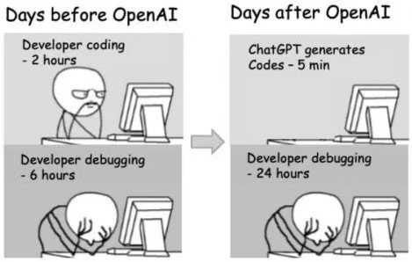
ARTIFICIAL INTELLIGENCE (AI)
Should we use AI?
Yes
Should we rely on AI?
No

Slide 7
TIPS FOR FUTURE B-TECH STUDENTS
Internships
Projects that matter
Clear core CS concepts
Get familiar with DOCs
Start preparing for placements
Aptitude and reasoning
DSA – leetcode, neetcode

Slide 8
THANK YOU

